Slide 1
Investigating whether different Type-1 diabetes prediction models can detect patients initially treated without insulin that rapidly progress to insulin treatment
Ethan de Villiers
ed546@Exeter.ac.uk

Slide 2
Background
30% of all adults with diabetes are initially treated as type 2 but rapidly progress to insulin (<3 years)
Implications of misdiagnosis?
What are characteristics of these patients?
Treat initially as T1 or T2?
Autoantibodies are common diagnostic tool for T1D but present flaws
Researchers at the University of Exeter have produced models to aid diagnosis
Models predict T1D probability
Can they detect T2D patients who will progress to insulin?
Notes:
Antibodies used but can have false positives, and false negatives and may not confirm type 1 diabetes where it may not be likely
Interpretation of antibodies depends on prior likelihood of T1D

Slide 3
Models
Clinical features model - (Age + BMI)
Clinical features and autoantibody model - (GAD + IA2)
Autoantibodies
Aim
Investigate how the 2 models classify non-insulin patients in comparison to how autoantibodies classify patients.
Can models detect patients who will progress to insulin
“high probability”?
Notes:
Add another model (Lipids model)
Look at antibody positive and antibody negative
Can investigate how clin f + antibody detects antibodies
Instead of picking out rapid insulin

Slide 4
Methods + Dataset
StartRight dataset (n = 1798)
Predominantly White European - UK
Selection Criteria
Not initially treated with insulin (n = 1000)
Keeping it basic
More robust definition could be:
Not treated with insulin within 3 months of diagnosis
Progressed = treated with insulin from visit 1, 2 or 3

Slide 5
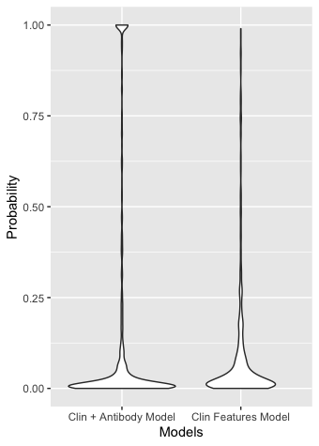
Clin model vs Clin + anti model
Sample: patients NOT initially treated with insulin
N = 1000
Clin + antibody segregates ”somewhat probable” patients into extremes

Slide 6
Clin Features Model
 | n = 976 | Number switched to Insulin | Mean Time to Insulin* (Weeks) | Mean HbA1c at diagnosis | Antibody- Antibody+ Antibody++ | Model Prob
High Risk >=0.667 | 36 | 66% | 33.94 | 84.60 | 42% 58% 25% | 0.82
Mid Risk 0.333 < x < 0.667 | 45 | 58% | 63.11 | 86.20 | 53% 47% 22% | 0.48
Low Risk <= 0.333 | 895 | 14% | 69.52 | 73.29 | 86% 14% 4.5% | 0.05

Slide 7
Clin Features and Autoantibody Model
 | n = 968 | Number switched to Insulin | Mean Time to Insulin (Weeks) | Mean HbA1c at diagnosis | Antibody- Antibody+ Antibody++ | Model Prob
High Risk >=0.667 | 93 | 85% | 58.35 | 89.16 | 3% 97% 64% | 0.94
Mid Risk 0.333 < x < 0.667 | 36 | 39% | 72.71 | 81.35 | 100% 0% 0% | 0.3
Low Risk <= 0.333 | 839 | 8.3% | 64.19 | 71.79 | 95% 5% 0% | 0.03
Low risk (<0.333) antibody positive
How were they treated?
Did they progress?
Why are they low risk?

Slide 8
Autoantibodies
 | n = 984 | Number switched to Insulin | Mean Time to Insulin (Weeks) | Mean HbA1c at diagnosis | Mean Clin Model prob | Mean Clin + Anti Model prob
Positive (1+) | 164 | 72% | 61.68 | 88.92 | 0.23 | 0.65
Negative (2-) | 820 | 7.6% | 68.74 | 71.29 | 0.07 | 0.03

Slide 9
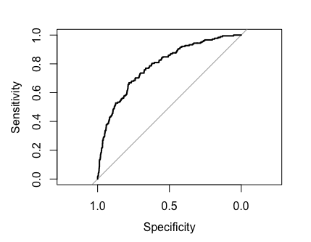
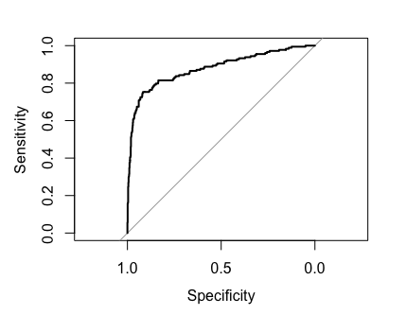
Roc Curves
Outcome = progressed to insulin (1)
Clin Features Model
Clin Features + Antibody Model
AUC = 0.7871
AUC = 0.8781
Notes:
Roc curves 0 for did not progress to insulin 1 for did progress
Roc curve (modelProbability, binaryDidProgress) – can develop modelProbability into binary with different thresholds for positive or negative

Slide 10
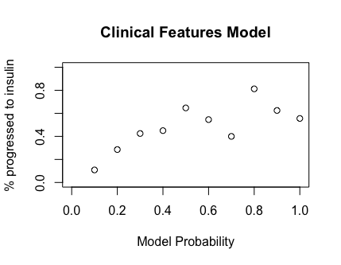
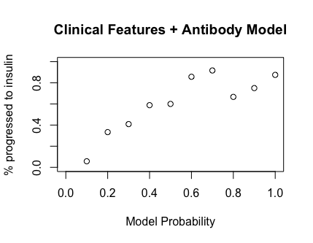
Calibration Plots
Notes:
Calibration plot = break probability into deciles and then plot what % of each decile has outcome positive
if model prob = 0.6 then do 60% of that decile have outcome?

Slide 11
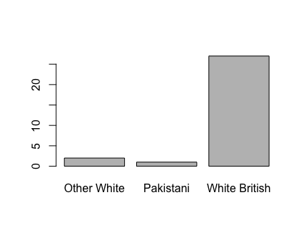
Low risk (<0.333) Antibody positive
 | n = 45 | Mean Time to Insulin* (Weeks) | Mean BMI (kg/m²) | Mean Age at Diagnosis | Mean HbA1c at diagnosis | GAD+ IA2+ ZNT8+ | Mean GRS Score*
Progressed to Insulin | 15 | 6.46 | 27.55 | 57.00 | 100.67 | 93% 7% 23% | 0.27
Did not progress | 30 | n/a | 34.90 | 52.37 | 73.81 | 73% 27% 0% | 0.24
* These GRS Scores should be compared to individuals initially treated with insulin = 0.25
Progressed
Remained
Notes:
Can see what factored into the decision to progress or not to insulin
- low risk score (model had no diagnostic effect on these individuals)
- high HbA1c
- No GRS difference
- Lower BMI
- SLIGHTLY older (10%)
- no Ethnic differences
- ZNT8+ indicates progressing

Slide 12
Conclusion
Model that factored autoantibodies better able to distinguish those who would progress to insulin
Placing them into a Higher risk category
Evident in ROC curves and calibration plots
Still individuals who should be detected but are not
5% - individuals who antibody+ but low risk
Autoantibodies best at predicting progression to insulin
184 patients progressed to insulin
Clinical features (>0.5) = 33 patients
Clinical features + autoantibodies (>0.5) = 92 patients
Autoantibodies (+) = 118 patients

Slide 13
APPENDIX – Clin Model Full Data
Clin Features Model
 | n = 976 | Clin Diag T1 | Clin Diag T2 | Number switched to Insulin | Mean Time to Insulin* (Weeks) | Mean BMI (kg/m²) | Mean Age at Diagnosis | Mean HbA1c at diagnosis | Model Prob | Antibody- Antibody+ Antibody++
High Risk >=0.667 | 36 | 56% | 21% | 66% | 33.94 | 23.29 | 25.58 | 84.60 | 0.82 | 42% 58% 25%
Mid Risk 0.333 < x < 0.667 | 45 | 44% | 38% | 58% | 63.11 | 25.05 | 33.04 | 86.20 | 0.48 | 53% 47% 22%
Low Risk <= 0.333 | 895 | 9.1% | 84% | 14% | 69.52 | 32.70 | 50.75 | 73.29 | 0.05 | 86% 14% 4.5%

Slide 14
APPENDIX – Clin + Anti Model Full Data
Clin Features and Autoantibody Model
 | n | Clin Diag T1 | Clin Diag T2 | Number switched to Insulin | Mean Time to Insulin* (Weeks) | Mean BMI (kg/m²) | Mean Age at Diagnosis | Mean HbA1c at diagnosis | Model Prob | Antibody- Antibody+ Antibody++
High Risk >=0.667 | 93 | 71% | 15% | 85% | 58.35 | 24.54 | 40.52 | 89.16 | 0.94 | 3% 97% 64%
Mid Risk 0.333 < x < 0.667 | 36 | 19% | 19% | 39% | 72.71 | 25.81 | 29.47 | 81.35 | 0.3 | 100% 0% 0%
Low Risk <= 0.333 | 839 | 3.9% | 90% | 8.3% | 64.19 | 33.18 | 50.31 | 71.79 | 0.03 | 95% 5% 0%

Slide 15
Patients who switched to Insulin (n = 184)
Group
Diagnosed T1 | Diagnosed T2 | Mean Time to Insulin (Weeks) | Mean HbA1c at diagnosis | Antibody- Antibody+ Antibody++ | Clin model prob | Clin + anti model prob
61% | 21% | 63.78 | 88.92 | 33% 64% 29% | 0.25 | 0.53
Individuals
Patient | Clin model prob | Clin + anti model prob | HbA1c at diagnosis | Time to Insulin (Weeks) | GAD+ | IA2+ | BMI | Age
1 | 0.5 | 0.86 | 89.00 | 16 | Y | N | 22.9 | 35
2 | 0.11 | 1.00 | 108.00 | 25 | Y | Y | 22.05 | 55
3 | 0.23 | 0.67 | 82.00 | 43 | Y | N | 29.67 | 32

